Slide 1
ADVANCED OPERATING SYSTEMS WITH UNIX
Aos- ch1-unit-1

Slide 2
What is an Advanced Operating System?
Evolved form of traditional OS
Traditional OS: Manages a single machine’s resources (CPU, memory, I/O).
Advanced OS: Extends functionality to manage multiple processors, distributed systems, cloud resources, and parallel computations.
Supports complex and large-scale computing
Supports Complex and Large-Scale Computing Designed for supercomputers, distributed systems, clusters, and cloud computing.
Can efficiently manage heterogeneous hardware and geographically distributed resources. Provides high performance and availability.
An Advanced Operating System (like Distributed OS, Multiprocessor OS, Real-Time OS, Cloud OS) provides concurrency, scalability, fault tolerance, and resource sharing, making it suitable for modern large-scale computing.
Key Features:
Concurrency
Scalability
Fault tolerance
Resource sharing

Slide 3
Key Features
Concurrency
Multiple processes/threads run simultaneously.
Supports parallel processing, synchronization, and interprocess communication (IPC).
Scalability
Efficiently manages growing workloads and system resources.
Works well in multiprocessor, distributed, and cloud environments.
Fault Tolerance
Detects, masks, and recovers from hardware/software failures.
Ensures reliability and continuous availability.
Resource Sharing
Facilitates efficient and secure sharing of CPUs, memory, storage, and networks among multiple users or systems.
Often uses virtualization and distributed resource management.

Slide 4
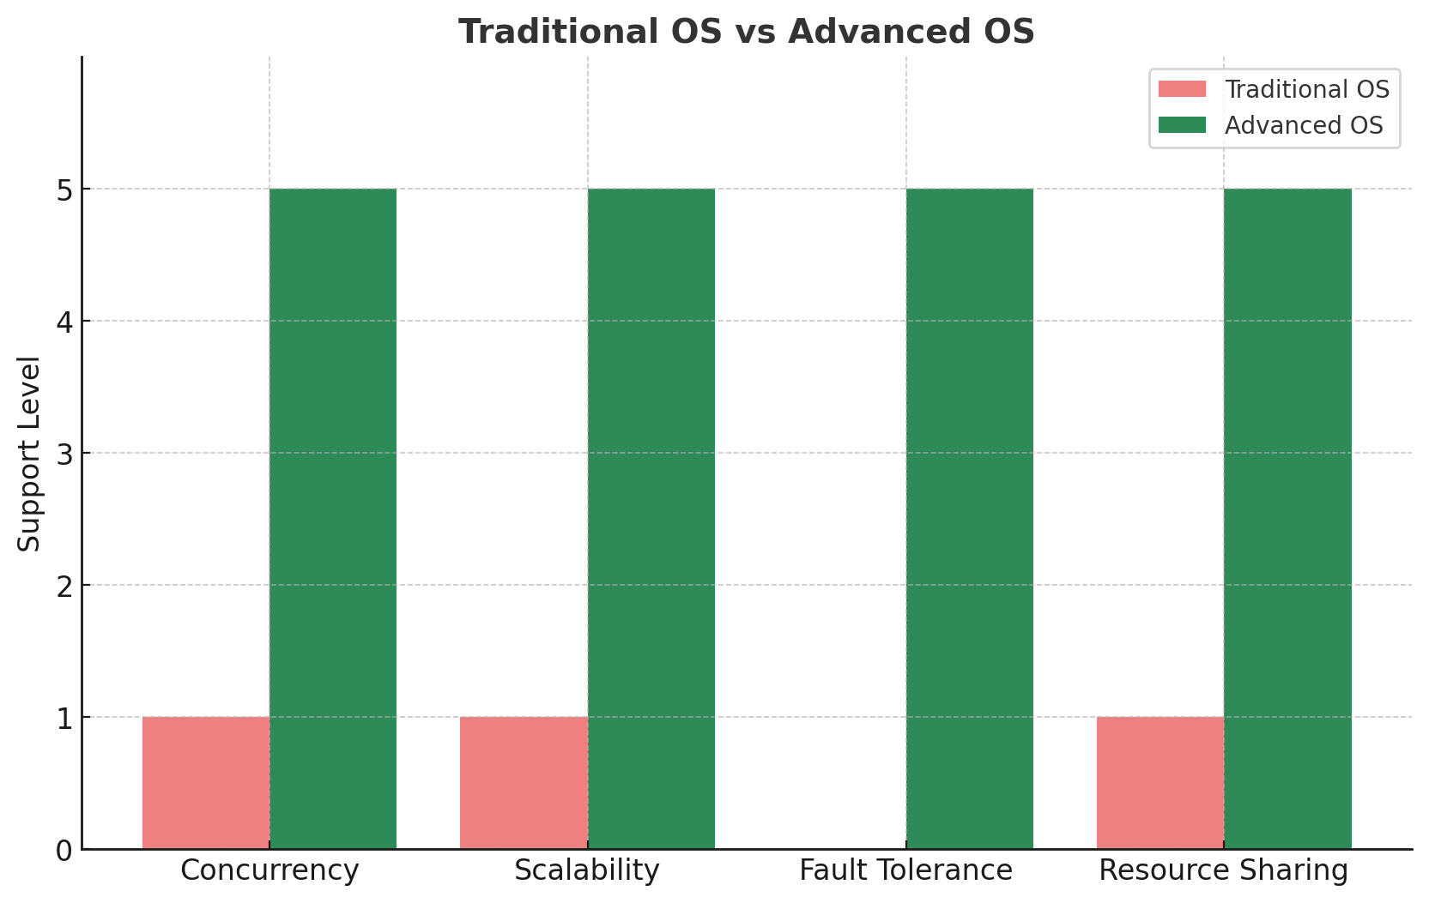

Slide 5
Types of Advanced Operating Systems
Distributed OS
Multiprocessor OS
Real-Time OS
Cloud-Based OS

Slide 6
1. Distributed Operating System (DOS)
A Distributed OS controls multiple independent computers (nodes) and presents them to the user as if they were a single coherent system.
The main idea: "One big virtual machine across a network".
How It Works
Each node has its own local memory and CPU but runs a part of the OS.
The system ensures transparency:
Access Transparency: Files/devices accessed uniformly regardless of location.
Location Transparency: User doesn’t need to know where the resource is physically located.
Replication Transparency: Multiple copies of data are hidden from the user.
Fault Transparency: System hides failures and continues running.
Use Cases
Cloud services, banking systems, stock trading systems, large-scale web apps.
Example: Google File System (GFS), Hadoop HDFS, Amoeba OS.

Slide 7
2.Multiprocessor Operating System (MPOS)
Runs on systems with multiple processors tightly coupled to a single shared memory and clock.
Two main types:
Asymmetric Multiprocessing (AMP) → One master CPU controls others.
Symmetric Multiprocessing (SMP) → All CPUs share equal responsibility.
How It Works
The OS schedules tasks across multiple CPUs.
Processes/threads can be executed in parallel, improving throughput.
Provides load balancing so one CPU isn’t overloaded.
Use Cases
Supercomputers, servers, parallel simulations, scientific computing.
Example: Linux SMP, Windows Server, Solaris.

Slide 8
3.Real-Time Operating System (RTOS)
RTOS is used where timing is critical.
The system guarantees deterministic response times.
Types
Hard RTOS: Missing a deadline is unacceptable. (e.g., missile defense systems).
Soft RTOS: Occasional missed deadlines tolerated. (e.g., video streaming).
How It Works
Uses priority scheduling (Rate Monotonic Scheduling, Earliest Deadline First).
Provides low latency interrupt handling.
Has a small, efficient kernel (unlike general-purpose OS).
Use Cases
Embedded systems, robotics, aerospace, automotive (engine control), medical devices.
Example: VxWorks, QNX, RTLinux, FreeRTOS.

Slide 9
4. Cloud-Based Operating System
Concept
Extends OS functions to manage cloud infrastructure and services.
Provides an interface for virtual machines, containers, and cloud applications.
How It Works
Uses virtualization (Hypervisors like VMware, KVM, Xen).
Manages on-demand resources (CPU, storage, networking).
Provides elastic scaling (automatically adding/removing resources).
Ensures multi-tenancy (isolation between multiple users/organizations).
Use Cases
Cloud computing, SaaS platforms, web hosting, enterprise IT.
Example: Google Chrome OS, OpenStack, Microsoft Azure OS, Cloud Foundry

Slide 10
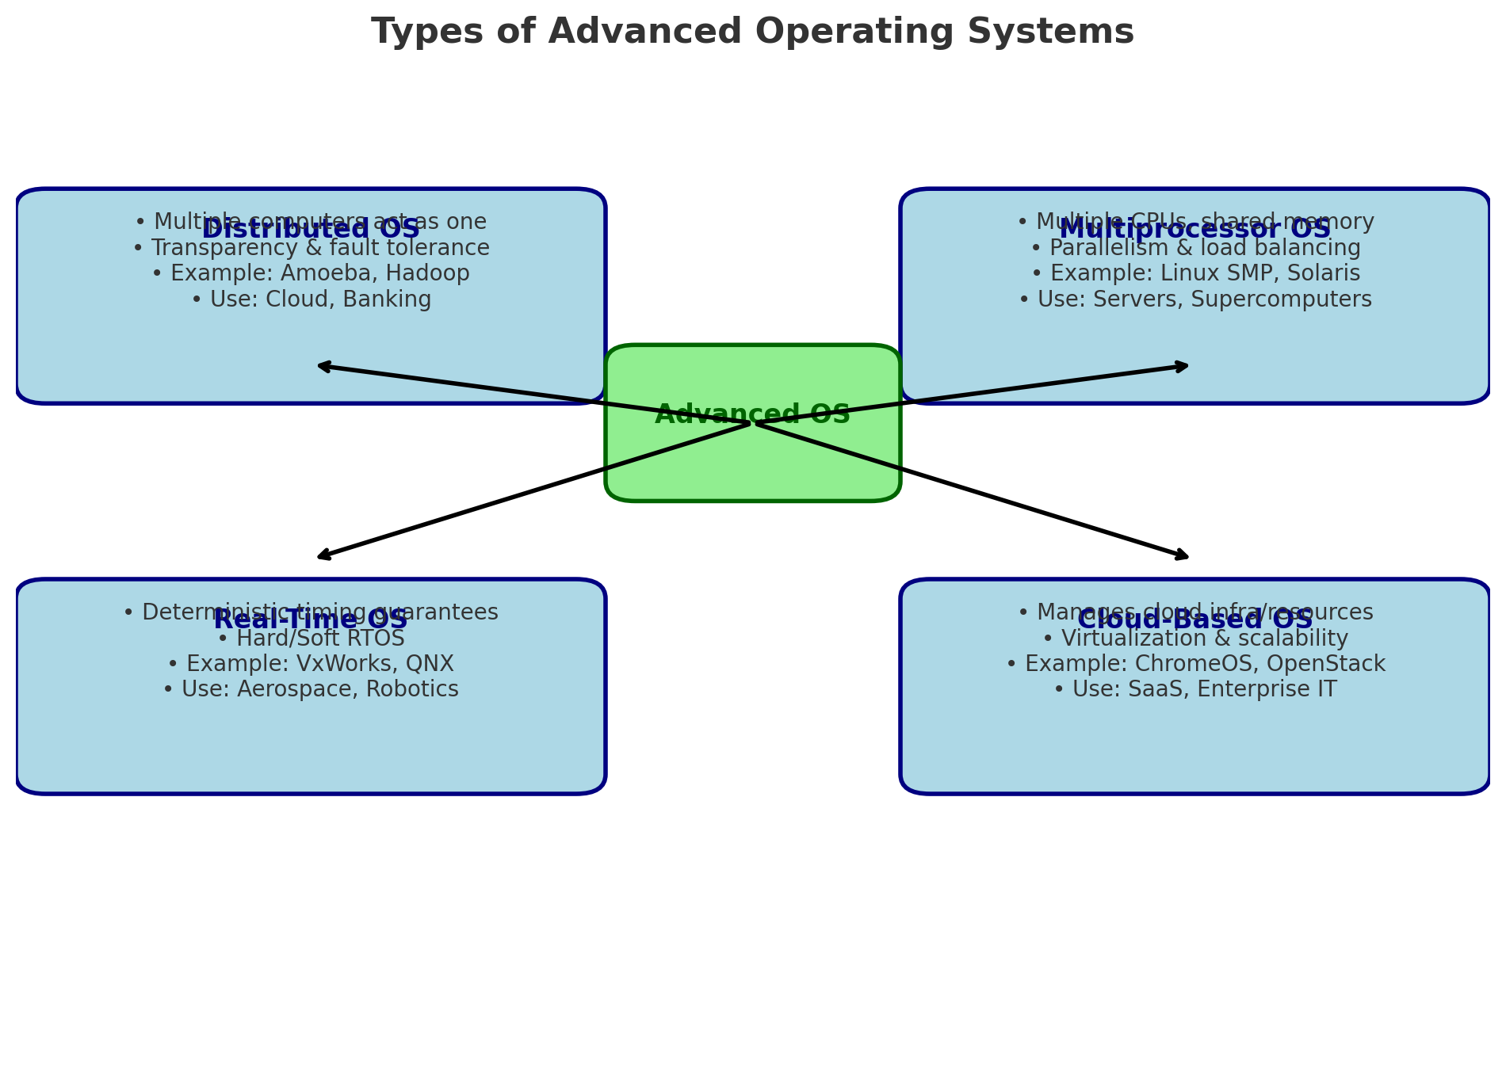

Slide 11
Type | Advantages | Disadvantages | Real-World Examples
Distributed OS | • High fault tolerance (system keeps running if one node fails) • Scalability (easy to add new machines) • Resource sharing across the network • Appears as a single system to users | • Complex design and management • Network dependency (failures affect performance) • Security is harder to maintain | Amoeba OS, Hadoop HDFS, Google File System, Plan 9
Multiprocessor OS | • High throughput via parallelism • Better CPU utilization • Load balancing across processors • Increased reliability (if one CPU fails, others work) | • Expensive hardware (multiple CPUs) • Complexity in scheduling and synchronization • Shared memory conflicts may occur | Linux SMP, Windows Server, Solaris, IBM AIX
Real-Time OS (RTOS) | • Predictable and deterministic execution • Low latency and fast response to events • Reliable for safety-critical tasks • Efficient resource utilization | • Limited multitasking compared to general OS • Complex to develop/debug • Requires specialized hardware/software | VxWorks, QNX, RTLinux, FreeRTOS
Cloud-Based OS | • Scalability & elasticity (resources scale on demand) • Cost-effective (pay-per-use model) • Resource virtualization (VMs, containers) • Multi-tenancy support | • Strong dependency on Internet • Data privacy & security concerns • Downtime affects all services | Google ChromeOS, OpenStack, Microsoft Azure OS, Cloud Foundry

